Slide 1
CUSTOMER SENTIMENT ANALYSIS
TEAM MEMBERS
GAURAV GARG-2210990318
DIVYAM PURI-2210990294
ESHAAN GARG-2210990308
NISHTHA TANDON-2210990621
Under the supervision
of
Mr. Shubham Singhal,
Mr. Jatin Arora
Chitkara University, Punjab

Slide 2
Introduction
Customer sentiment analysis is a powerful tool that businesses use to gauge the opinions, emotions, and attitudes of their customers towards their products, services, or brand. By analyzing text data from sources such as social media, customer reviews, sentiment analysis can provide valuable insights into how customers perceive a company and its offerings. This introductory process involves the use of natural language processing (NLP) and machine learning techniques to classify opinions as positive, or negative helping businesses understand customer satisfaction levels, identify emerging trends, and make data-driven decisions to improve products and services.

Slide 3
WHY?
Understanding Customer Satisfaction: By analyzing customer sentiments, businesses can gain insights into how satisfied their customers are with their products or services.
Identifying Trends and Patterns: Sentiment analysis helps businesses uncover emerging trends and patterns in customer feedback.
Monitoring Brand Perception: Businesses can use sentiment analysis to monitor how their brand is perceived by customers in real-time.

Slide 4
PROBLEM STATEMENT
"In today's highly competitive business landscape, understanding and responding to customer sentiments are paramount for sustainable success. However, with the vast amount of unstructured data generated by customers across various channels such as social media, reviews, and surveys, extracting actionable insights poses a significant challenge for businesses. The problem at hand is to develop an effective customer sentiment analysis system that can automatically analyze and classify customer sentiments into positive, negative, or neutral categories. “

Slide 5
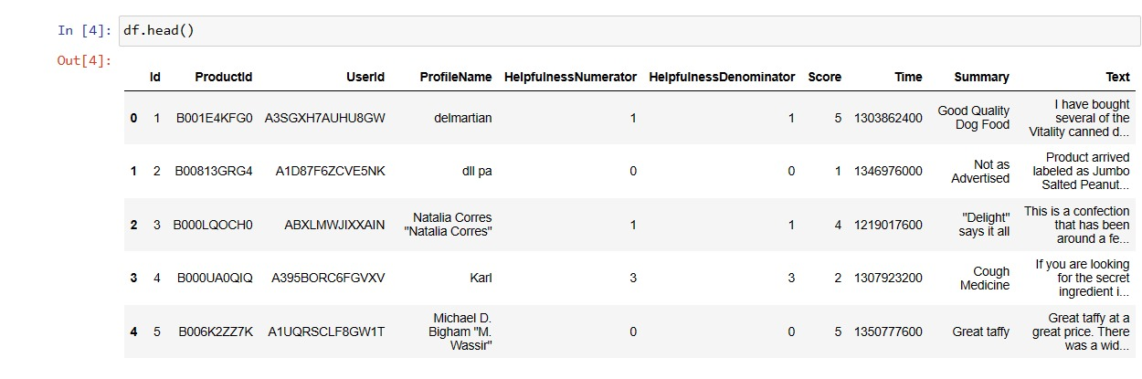
Code Snapshots
In our dataset there are columns containing Id, ProductId , UserId, ProfileName, HelpfullnessNumerator, HelpfullnessDenominator, Score, Time, Summary, Review Text

Slide 6
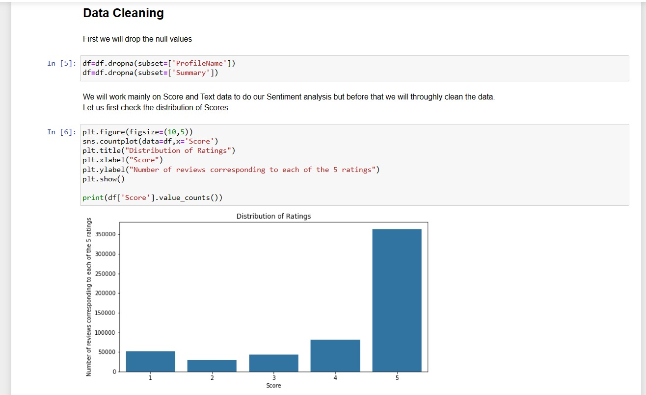

Slide 7
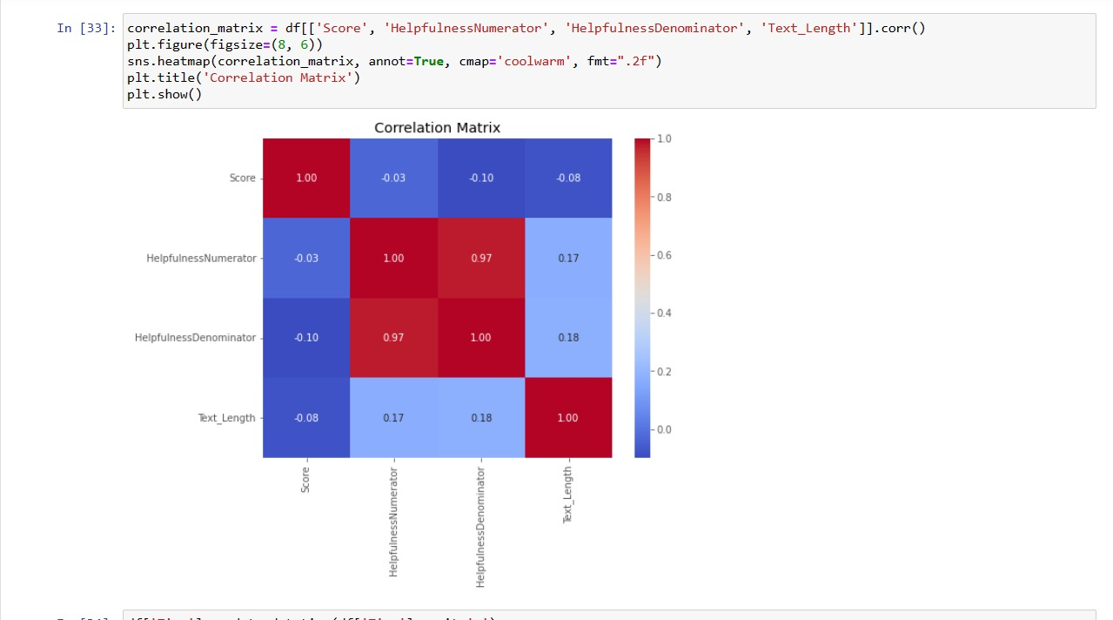

Slide 8
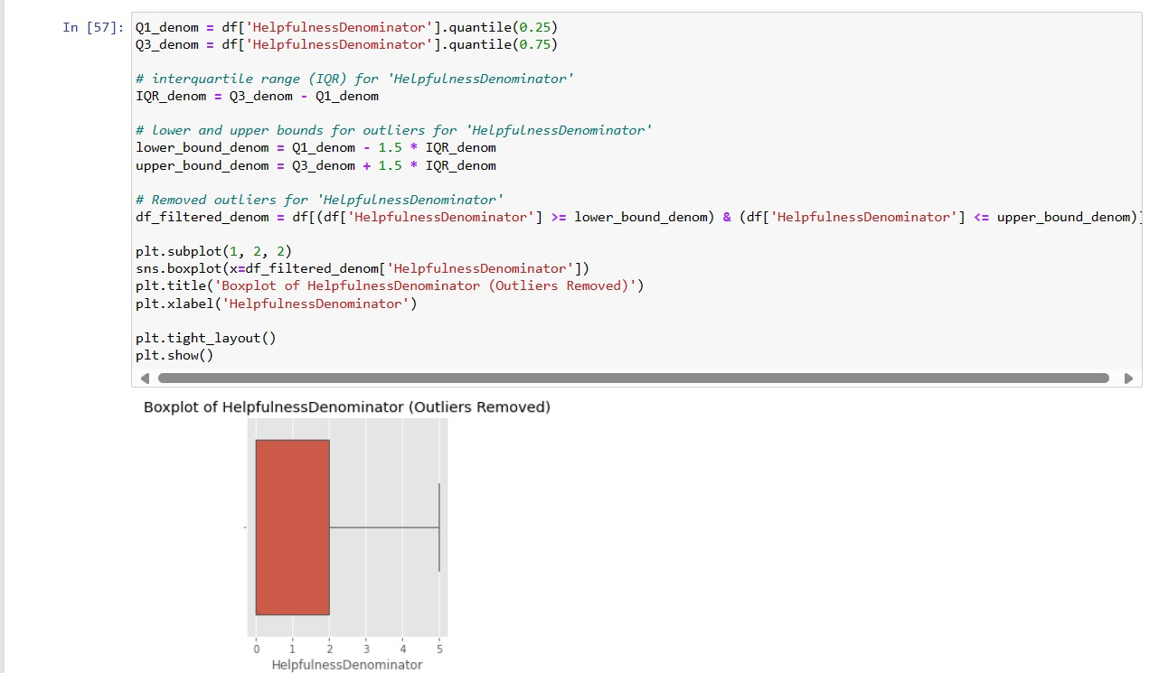
CODE SNAPSHOTS

Slide 9
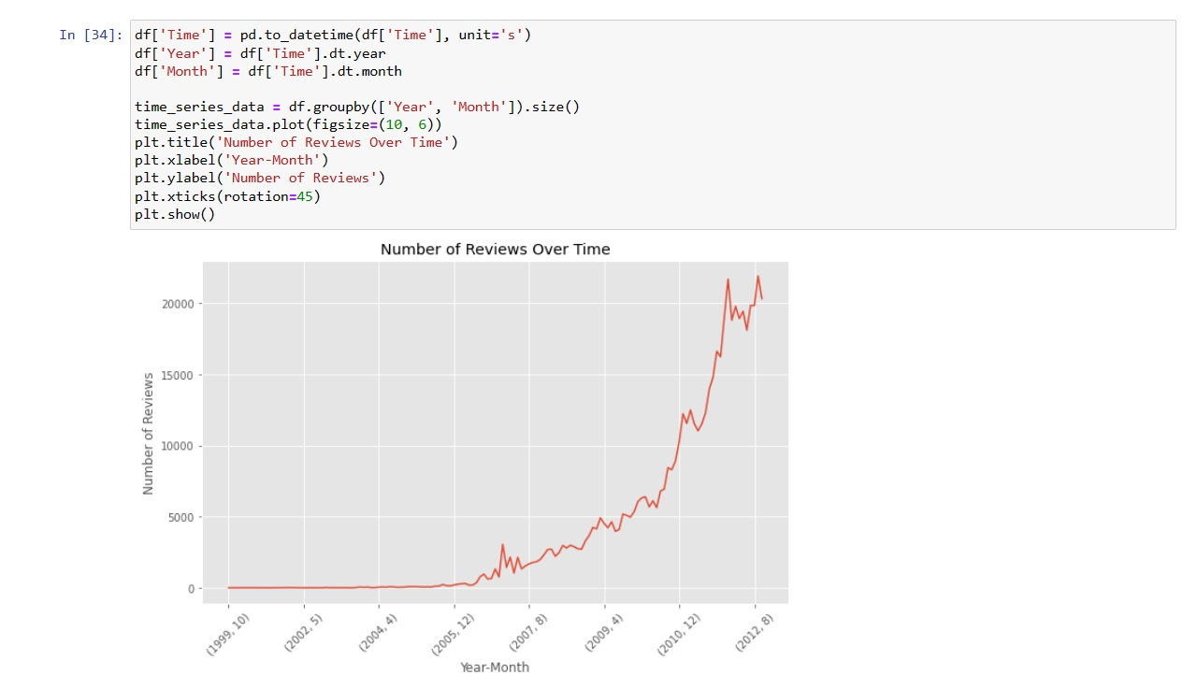
CONTINUED..

Slide 10
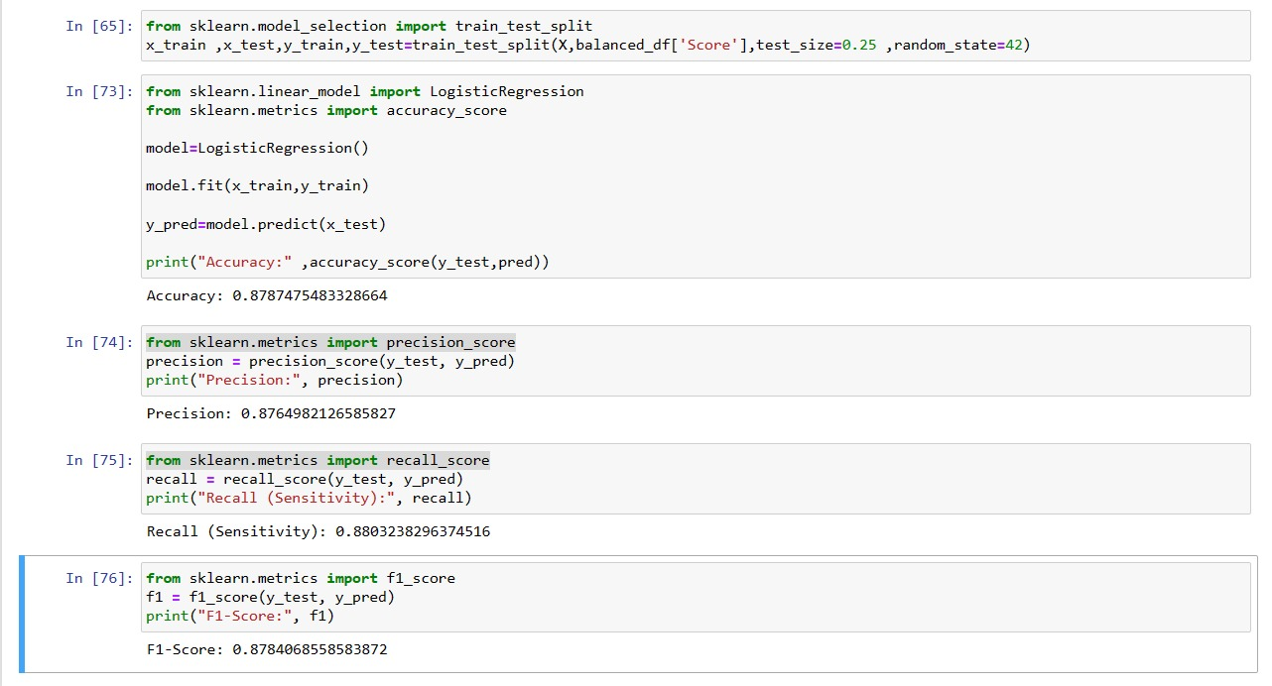
Result

Slide 11
MOTIVATION OF RESEARCH
Understanding Customer Feedback: Amazon receives a massive volume of reviews for its products, ranging from books to electronics to groceries. Analyzing the sentiment of these reviews helps Amazon understand how customers feel about specific products and their experiences with them. Positive sentiment indicates satisfaction, while negative sentiment may highlight areas for improvement.
Product Improvement: By analyzing customer sentiment, Amazon can identify recurring patterns in feedback. If many customers express dissatisfaction with a particular aspect of a product, such as its durability or usability, Amazon can use this information to guide product improvements or modifications.
Informing Purchase Decisions: Customer reviews play a crucial role in informing the purchase decisions of other customers. Sentiment analysis helps summarize the overall sentiment of reviews, making it easier for potential buyers to quickly gauge the general consensus about a product. Positive sentiment is likely to attract more customers, while negative sentiment may deter potential buyers.
Brand Reputation Management: Monitoring sentiment in customer reviews allows Amazon to manage its brand reputation effectively. By promptly addressing issues raised in negative reviews and leveraging positive feedback, Amazon can maintain a positive brand image and build customer trust and loyalty.

Slide 12
Tools & Technologies
In this we have used :
Programming Languages:
Python: Python is a popular choice for sentiment analysis tasks due to its extensive libraries and packages for natural language processing (NLP) and machine learning. Libraries like NLTK, and scikit-learn provide robust tools for text preprocessing, feature extraction, and sentiment classification.
NLP Libraries and Frameworks:
NLTK (Natural Language Toolkit): NLTK is a comprehensive library for NLP tasks in Python. It provides tools for tokenization, stemming, lemmatization, and sentiment analysis, among other tasks.

Slide 13
Machine Learning Algorithms:
Logistic regression is a statistical method for analyzing a dataset in which there are one or more independent variables that determine an outcome. In sentiment analysis, the independent variables are typically features extracted from text data, and the outcome is the sentiment of the text (positive, negative
Visualization Tools:Matplotlib and Seaborn: These Python libraries are commonly used for creating visualizations to explore and interpret sentiment analysis results.

Slide 14
Conclusion
Our analysis involved the following steps:
1. Data Collection: We collected a large dataset of Amazon reviews spanning various product categories to ensure diversity in the dataset.
2. Data Preprocessing: The collected data underwent extensive preprocessing steps, including text cleaning, removal of stopwords, punctuation, and other irrelevant characters, as well as stemming or lemmatization to normalize the text.
3. Model Development: We built a machine learning or deep learning model for sentiment analysis. This model was trained on the preprocessed Amazon review data to predict the sentiment of new reviews as positive or negative.
4. Evaluation: The performance of the sentiment analysis model was evaluated using appropriate evaluation metrics such as accuracy, precision, recall, and F1-score. This helped us assess how well the model generalizes to new, unseen data.
5. Insights: Our analysis revealed valuable insights into customer sentiment towards Amazon products. We observed positive sentiment predominates in reviews.

Slide 15
References
We have taken reference from :
https://www.geeksforgeeks.org/machine-learning/
https://aws.amazon.com/what-is/sentiment-analysis/
https://www.kaggle.com/datasets/arhamrumi/amazon-product-reviews/data

Slide 16


